Slide 1
Olympic Games Analysis

Slide 2
Content
This analysis explores key trends, important observations, and significant results from the Olympics dataset. It examines how countries perform across different Olympic Games, highlights the sports and athletes that dominate the medal charts, and uncovers patterns related to medal distribution over time. By analyzing historical Olympic data, the study aims to provide valuable insights into the factors contributing to athletic success, the emergence of new sports, and the evolving global landscape of the Olympic Games.

Slide 3
Observations
Medal Distribution:
Certain countries consistently lead in medal counts (e.g., USA, China, Russia).
Host countries often see a boost in their medal tally.
Athlete and Event Analysis:
Swimming and Athletics account for the majority of medals awarded.
Some athletes, like Michael Phelps, dominate across multiple Olympic Games.

Slide 4
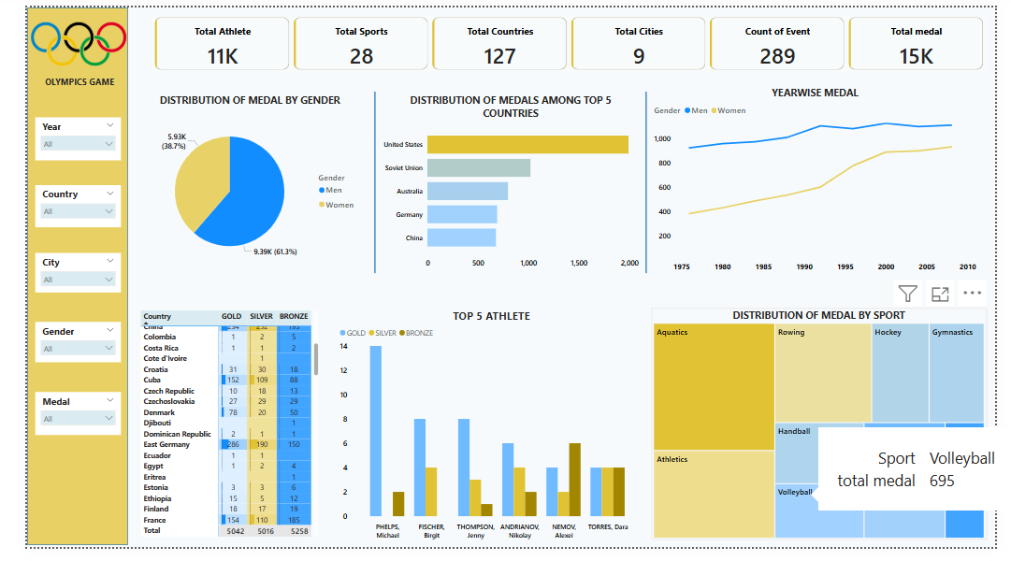

Slide 5
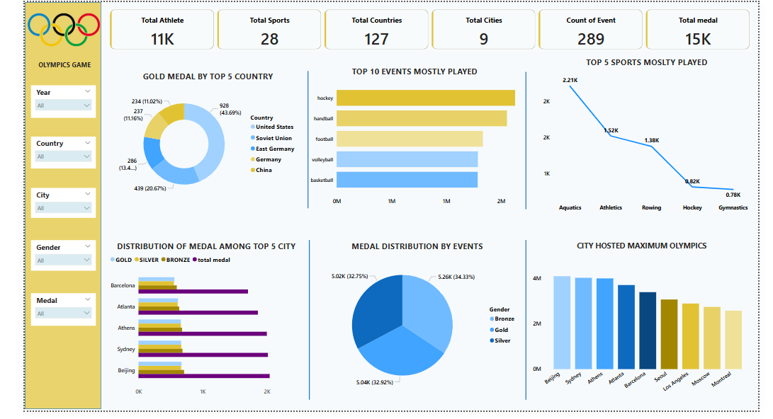

Slide 6
Result
1. Medal Distribution by Gender:
Men: 61.3% of total medals (~9.39K medals)
Women: 38.7% of total medals (~5.93K medals)
Insight: There is a significant but narrowing gender gap — male athletes have historically won more medals than females.
2. Top Performing Countries:
United States leads overwhelmingly in total medals.
Followed by Soviet Union, Australia, Germany, and China.
Insight: Dominance is evident from a few traditional sporting superpowers.

Slide 7
3. Year-wise Medal Trends:
Medals for both Men and Women have steadily increased over time.
Female medal counts especially show a sharp rise starting around 1985–1990.
Insight: Growing female participation and success over recent decades.
4. Top Athletes:
Michael Phelps (Swimming) is the most decorated with a huge number of medals.
Other notable athletes: Birgit Fischer, Jenny Thompson, Nikolay Andrianov, and Dara Torres.
Insight: Swimming has produced several multi-medal winning legends.
5. Medal Distribution by Sport:
Aquatics (Swimming) and Athletics (Track & Field) dominate the total medals awarded.
Other strong sports include Rowing, Hockey, Gymnastics, Handball, and Volleyball.
Insight: Aquatics and Athletics offer the most medal opportunities for athletes.
6. Medal Table Snapshot:
Country-level performance shows traditional dominance by a few European and American countries.
For example, Cuba and France show consistent medal wins across all types (Gold, Silver, Bronze).

Slide 8
7.Gold Medal by Top 5 Countries
United States: 928 golds (43.69% of top 5 total)
Soviet Union: 439 golds (20.67%)
East Germany: 286 golds (13.4%)
Germany: 237 golds (11.16%)
China: 234 golds (11.02%)
Insight: The USA dominates gold medals with almost double the total of the second-placed Soviet Union.
8.Top 5 Events Mostly Played
Sports like Hockey, Handball, Football, Volleyball, and Basketball are played the most based on event participation.
Insight: Team sports have massive participation, indicating their worldwide popularity and inclusiveness.
9.Top 5 Sports Mostly Played
Aquatics: 2.21K events
Athletics: 1.52K events
Rowing: 1.38K events
Hockey: 0.82K events
Gymnastics: 0.78K events
Insight: Aquatics and Athletics dominate not just medal counts but also in the number of events, offering athletes the most medal opportunities.

Slide 9
10. Distribution of Medals Among Top 5 Cities
Barcelona, Atlanta, Athens, Sydney, and Beijing — each hosted significant Olympics with large medal distributions.
Beijing and Sydney stand out slightly ahead.
Insight: Hosting Olympics is associated with large-scale participation and high medal volume.
11.Medal Distribution by Event
Gold: 5.26K (34.33%)
Silver: 5.02K (32.75%)
Bronze: 5.04K (32.92%)
Insight: Medal distribution across Gold, Silver, and Bronze is almost perfectly balanced, showing fairness and standard structuring in event outcomes.
12.City Hosting Maximum Olympics
Beijing, Sydney, Athens, Barcelona, Seoul, Los Angeles, Moscow, and Montreal listed.
Beijing and Sydney lead in terms of total participation/scale.
Insight: These cities have hosted or organized some of the most successful and largest Olympic events in history.

Slide 11
Key Observations
Host Country Advantage: If cross-mapped, host countries like USA, Australia, and China likely saw medal boosts during their hosting years.
Sport-Specific Dominance: Some countries specialize heavily in certain sports (e.g., China in gymnastics, USA in swimming).
Emergence of New Events: The rise in total event count suggests new events are introduced to promote inclusiveness and modernization.
USA's gold medal dominance is exceptionally clear.
Team sports (hockey, football, basketball) are crowd favorites and draw major athlete participation.
Aquatics and Athletics are the backbone of the Olympics — both in medals and events.
Medal distribution among Gold/Silver/Bronze is incredibly well-balanced.
Beijing emerges as a standout city for hosting successful large-scale Games.

